Slide 1


love the new
iSense:
Enabling Independent Navigation for the Blind People

Slide 2

Table of Contents
Team Details
Problem Statement
What is your idea for the solution?
Architecture
What domains does it address? What is the impact?
Technologies Leveraged
Model that made our project possible
Demo
Financial Feasibility

Slide 3
Team Details
Team Name | Member Names | Education Institute Name
Corporate Visionaries | Ruchita Raut | Intelliswift Software, Inc.
 | Shekhar Hippargi | Intelliswift Software, Inc.

Slide 4
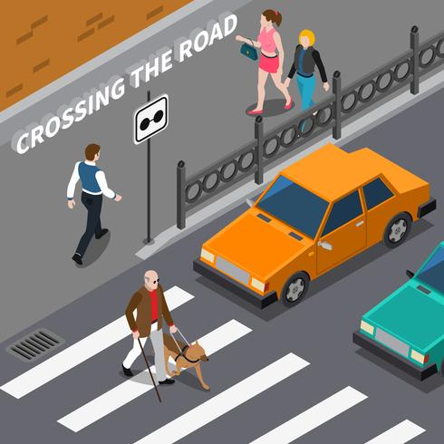
Problem Statement
According to NIH India (nih.gov), there are an estimated 4.95 million people blind (0.36% of the total population), 35 million people visually impaired (2.55%), and 0.24 million blind children in India. ​
The problem faced by blind individuals revolves around obstacles in daily living due to the absence or limitation of sight. This includes difficulties in navigation, accessing information, performing routine tasks independently, and experiencing challenges in various environments without visual assistance.

Slide 5
What is your idea for the solution?
The aim of this project is to develop a comprehensive assistive low-cost navigation system in real-time tailored for visually impaired individuals to safely and independently navigate urban environments. ​
The system will focus on aiding users in locating the nearest crosswalk and/or traffic signal, providing real-time navigation guidance to reach the destination, by incorporating various Google Maps APIs and offering auditory cues.​
Here, we are using Generative AI for voice assistant to empower visually impaired individuals by providing seamless auditory guidance, real-time environmental descriptions, enhancing their independence and navigation in the world around them and give human-like response.

Slide 6
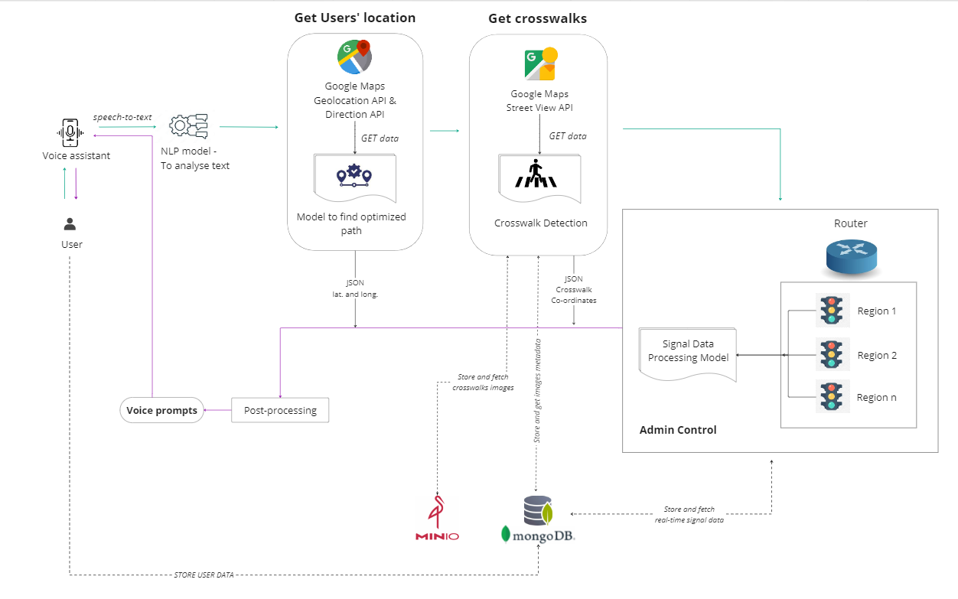
Architecture

Slide 7
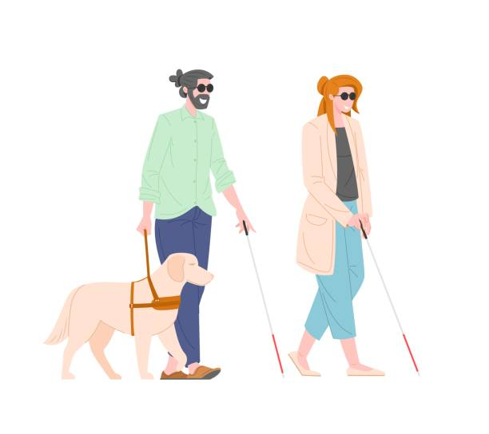
What domains does it address? What is the impact?
Our idea addresses Social Welfare domain crucial for the accessibility and safety of blind people.
This solution has a profound impact on the independence, safety, and confidence of visually impaired individuals, empowering them to navigate urban environments with greater ease and security.

Slide 8

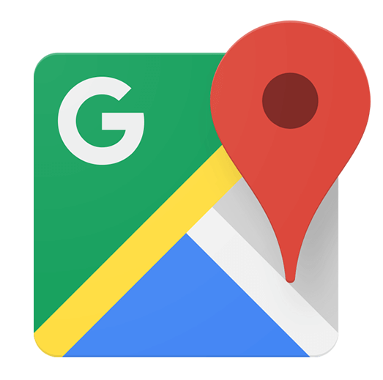



Technologies Leveraged
Voice Assistant: To interact with user.​
Generative AI: To improve the quality of voice assistance and provide more natural-sounding responses.​
Google Maps Geolocation API: To get real-time location of user and crosswalks.​
Google Maps Direction API: To get the optimized path from source to destination.​
Google Maps Street View API: To generate video of crosswalks along the optimized path detected.​
Computer Vision / Deep Learning: Developed Yolov8 model to detect crosswalks from the video.​
Python: To create custom REST APIs, to create deep learning model, manage workflow.​
MongoDB: To store users' data, Store Signal data, and metadata of images generated from Street View API.​
MinIO: It is an open-source High-Performance Object Storage. Here, we are storing images. Alternatives of MinIO are GCP's Cloud Storage and Amazon S3.

Slide 9
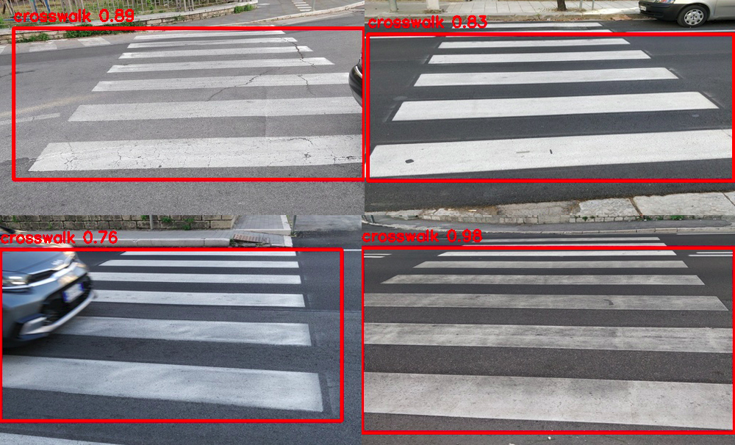
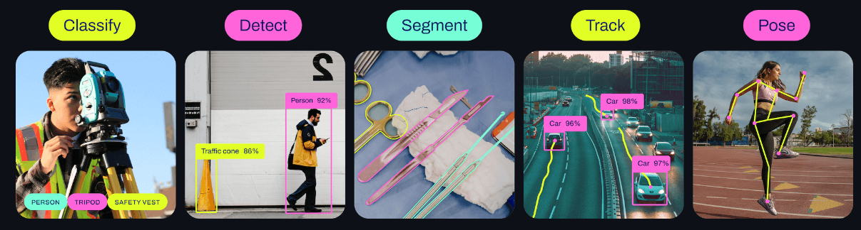
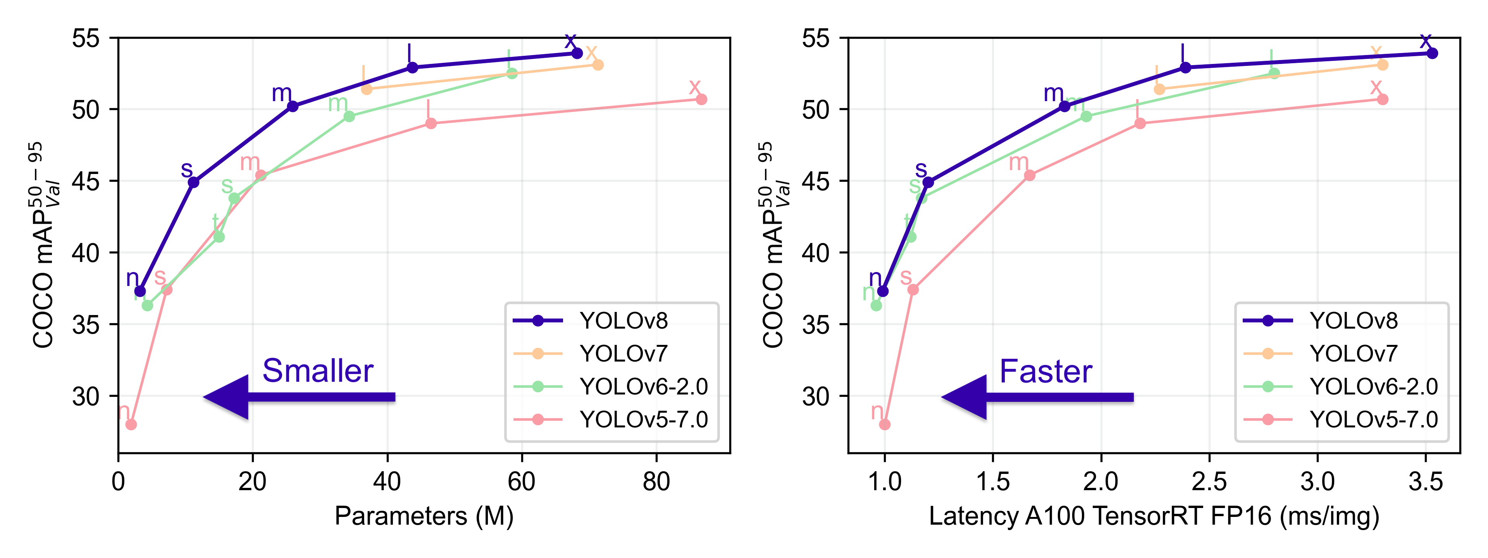
Models that made our project possible
YOLOv8:
YOLOv8 is a cutting-edge, state-of-the-art model built by Ultralytics to obtain high accuracy and perform real-time predictions.
Here, we are using this model to detect Crosswalks from the images/videos.
Notes:
YOLOv8 is designed to be fast, accurate, and easy to use, making it an excellent choice for a wide range of object detection and tracking, instance segmentation, image classification and pose estimation tasks.
YOLOv8 is a state-of-the-art object detection, image classification, and instance segmentation model built by Ultralytics. It is known for its high accuracy and real-time performance, making it an excellent choice for a wide range of applications. YOLOv8 is based on the anchor-free detection approach, which eliminates the need for predefined anchor boxes, leading to more efficient and accurate object detection.
Some of the key features of YOLOv8:
Fast and accurate, Easy to use, Versatile, and open-source

Slide 10

ChatGPT4 + Speech Recognition
Some of the key benefits of using ChatGPT 4: Improved accuracy and fluency: ChatGPT 4 can generate more accurate and fluent text than the original ChatGPT. This means that conversations with ChatGPT 4 will be more natural and engaging.
Better understanding of context: ChatGPT 4 has a better understanding of context than the original ChatGPT. This means that it can follow instructions better and provide more relevant responses.
Ability to generate different creative text formats: ChatGPT 4 can generate different creative text formats, such as poems, code, scripts, musical pieces, email, letters, etc. This makes it a more versatile tool for chatbot developers.

Slide 11
DEMO

Slide 12
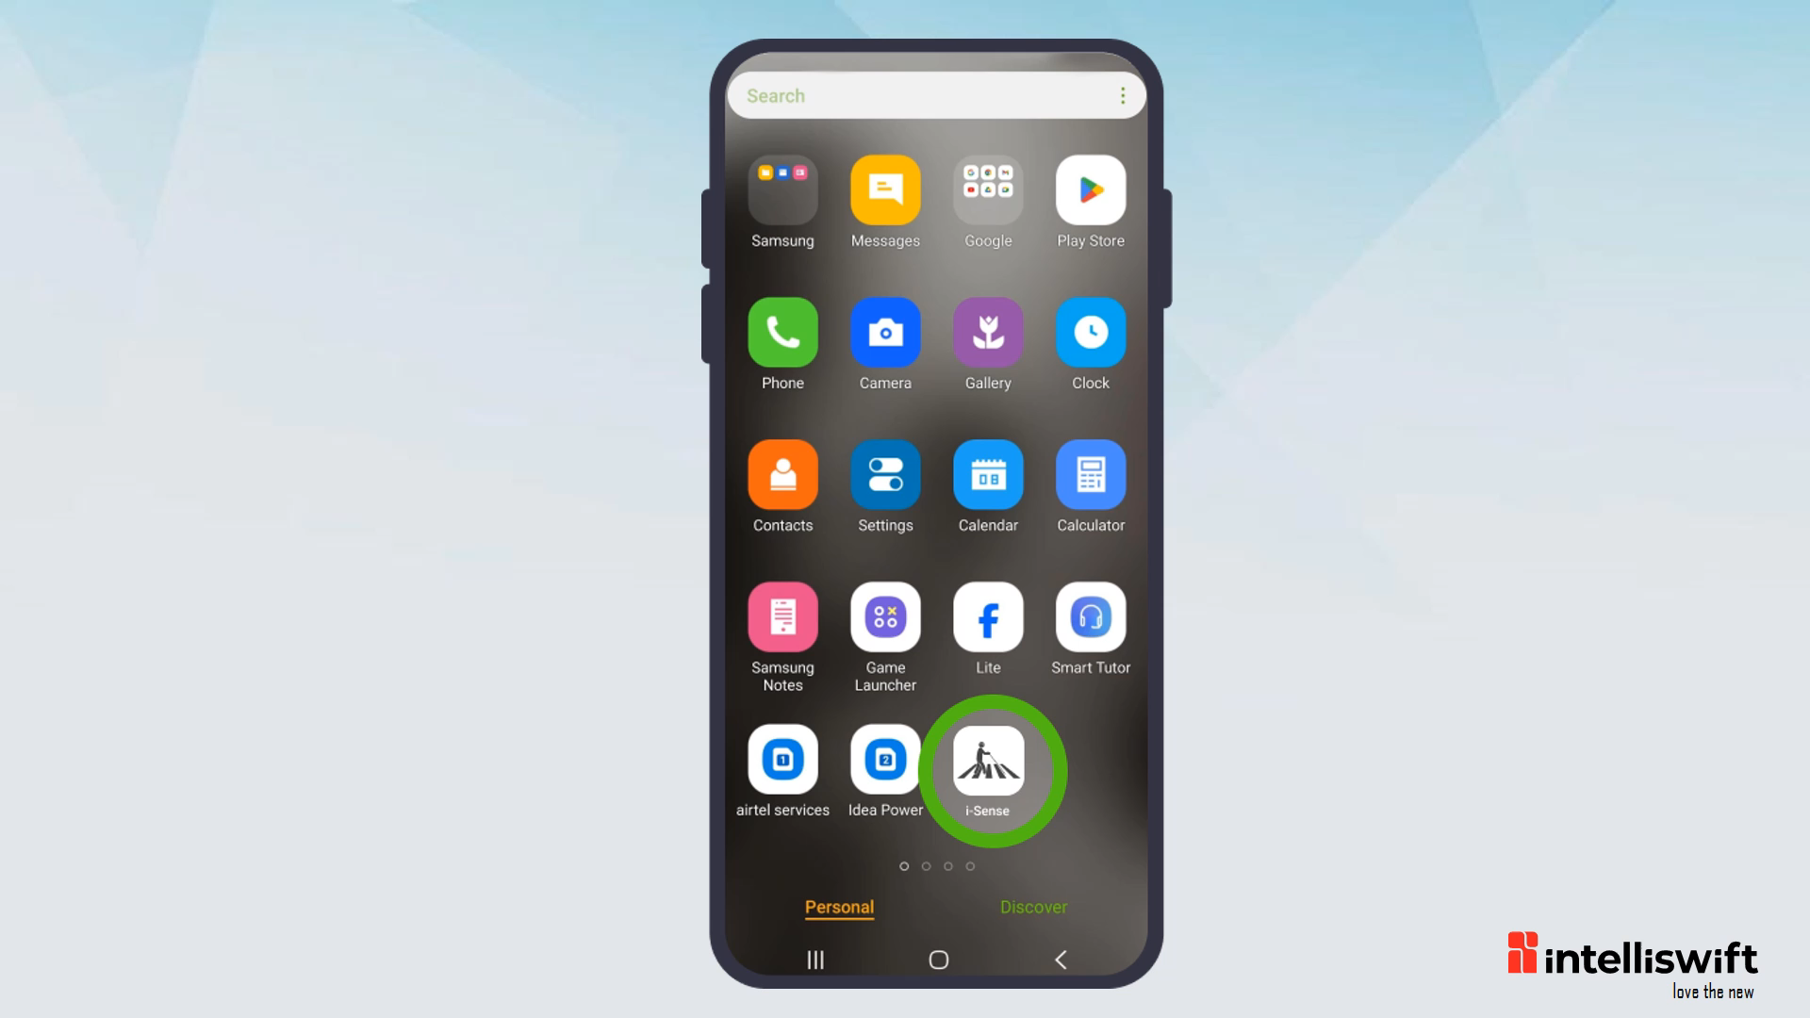

Slide 13
Financial Feasibility
Initial Development Costs: Most of the open-source technologies like Deep Learning model, Python, Mobile Apps are used to develop the solution. The minimal costing will be for Google Maps APIs, OpenAI and deployment of the solution.
Revenue Streams: This includes sales of assistive devices or mobile apps, subscription models, licensing technology to other entities (NGOs / Trusts), or partnerships with Government organizations.
Monetization Strategy: The strategy for the ROI can be gained by incorporating subscription tiers with estimated minimal costings, potential revenue-sharing agreements with partners.
Notes:
While the implementation of such a system can incur initial development and operational costs, it also holds potential for sustainable revenue generation and positive societal impact.

Slide 14
Enhancements
Utilizing the camera to capture the user's surroundings and provide audio descriptions of the scene, including details about nearby objects, people, obstacles, or environmental conditions, helping the user understand their environment.
Integration with Smart Wearables: Consider integrating the app with smart wearable devices (such as smartwatches) to provide navigation alerts and instructions hands-free, further enhancing convenience for users.

Slide 15
Resources
Prototype GitHub Link:-
https://github.com/shekhar-hippargi/Hackathon-CorporateVisionaries
Object Detection model (YOLOv8):
https://github.com/ultralytics/ultralytics
Street View API:
https://developers.google.com/maps/documentation/streetview/overview
Geolocation API:
https://developers.google.com/maps/documentation/geolocation/overview
Directions API:
https://developers.google.com/maps/documentation/directions/overview

